Slide 1
Panel II - Future of Competitive Transmission in the PJM Footprint December 1, 2016 Chip Richardson – PPL Electric Utilities

Slide 2
$7.7 billion in annual revenue
10.5 million utility customers in the U.S. and U.K.
13,000 employees
About 8,000 MW of regulated generation capacity in the U.S.
41 J.D. Power awards for customer satisfaction

Slide 3
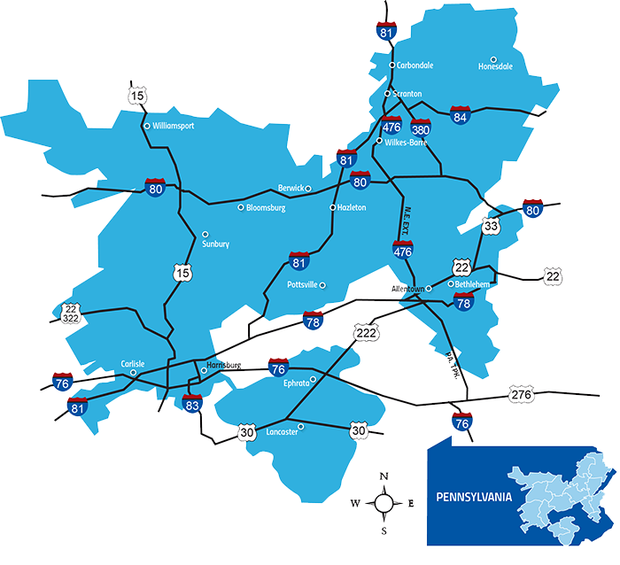
1.4 million utility customers in northeast Pennsylvania
Maintains 48,000 miles of power line
24 J.D. Power awards for top-quality service to our residential and business customers
Investing more than $5B over the next five years to improve the electric service system

Slide 4
Where are we at?
In the throes of initial implementation and acting upon “Lessons Learned”, examples include:
Improving efficiency and effectiveness by removing required exclusions from the open window process
Revising fee structure for evaluation of proposals
Streamlining system planning study processes to align with the open window process
Modest competitive opportunities, the net benefits of which are unclear at this time

Slide 5
Success is a matter of perspective
Advocates for the reforms the Commission enacted in Order 1000 envisioned bold transformations of the transmission grid, examples include:
A new Extra High Voltage eastern interconnection overlay
Interconnection of the U.S. Eastern and Western grids
Multi billion dollar transmission linking mid-west wind generation to east coast load centers
Multi billion dollar “build it and they will come” projects for collecting and distributing off shore wind throughout the mid-Atlantic

Slide 6
Success is a matter of perspective (continued)
FERC put forward a triad of reforms to ensure that new needed transmission would get built:
Incorporation of Public Policy needs and cross regional planning protocols
Competition in transmission planning to bring innovative and bold project ideas to address needs beyond utility/state/RTO boundaries
Requirements for cross region project cost allocation

Slide 7
In PJM
Public Policy needs have not come to the forefront as significant drivers of new transmission (as they have in other RTO/ISOs)
Steady decline in load growth since 2010 has reduced the need for new regional transmission
Conservative cross border (RTO/ISO) planning processes
Originally envisioned and competitively driven bold and transformative projects have not materialized
Concern that competition may devolve to a narrowly focused “cost to build” competition for a limited amount of small scope projects with routine solutions – a race to the bottom

Slide 8
The future of competition in PJM
Developers pursing emerging niche opportunities:
Storage
Generator attachment facilities
Events that may create additional competitive opportunity:
Carbon reduction goals
Dramatic economic upturn
Federal infrastructure stimulus projects
Federal siting for cross regional projects
Expanded cross regional (RTO/ISO) planning
Transmission system resiliency
Additional process improvements needed
Clarity on cost caps
Clarity on competitive proposal evaluation methods

